Slide 1


Slide 2
Image Recognition Using Factorial Design Experiment
22MDT1009 Sagnik Chakravarty
22MDT1024 Swapneel Chanda
22MDT1081 Sahas Parab
Guided by : Dr. Kalyan Banerjee

Slide 3
Introduction
In the realm of computer vision and image recognition, the accurate and efficient analysis of visual data has become increasingly crucial across numerous applications.
From self-driving cars to medical imaging, the ability to accurately interpret and understand images has paved the way for groundbreaking advancements.
To achieve optimal performance in image recognition systems, researchers and engineers often employ factorial design principles.
Factorial design allows for comprehensive exploration of various factors and their interactions, enabling the identification of the most influential factors and their optimal settings.

Slide 4
Methodology
We have taken the CIFAR-10 dataset which is an inbuilt dataset in Keras for this project.
CIFAR-10 is an inbuilt image recognition dataset with very low res images of 32x32 pixel
We have then applied the CNN on the dataset and then we tried to find out the performance metric for the CNN
We then applied Factorial Design experiment, DenseNet, VGGNet, GoogleLeNet, ResNet on the images and again found out about the performance metrics using this technique
We at last compare both the method to find which is better suited

Slide 5
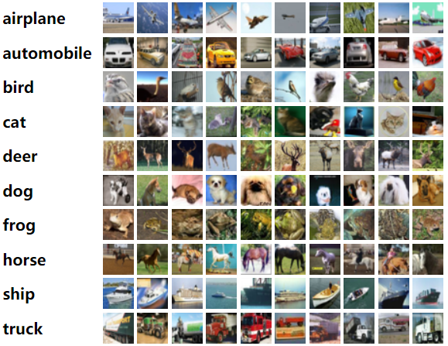

Slide 6
What is CNN
Convolutional Neural Network (CNN) is the extended version of artificial neural networks (ANN) which is predominantly used to extract the feature from the grid-like matrix dataset. For example visual datasets like images or videos where data patterns play an extensive role.

Slide 7
What is GooleLeNet
GoogleLeNet (Inception v1) is a convolutional neural network architecture developed by Google, known for its groundbreaking use of inception modules that capture information at multiple scales and reduce computational complexity.
It won the ImageNet Large-Scale Visual Recognition Challenge (ILSVRC) in 2014, demonstrating its superior performance in image classification tasks.
GoogleLeNet's efficient design with 22 layers and 1x1 convolutions enabled it to achieve high accuracy while minimizing the number of parameters.
The model's inception modules combine filters of different sizes within a layer, allowing it to capture both local and global features effectively.

Slide 8
What is DenseNet
1. DenseNet is a deep learning architecture that was introduced in 2016, known for its densely connected layers that facilitate information flow and promote feature reuse throughout the network.
2. Unlike traditional convolutional neural networks, DenseNet establishes direct connections between every layer, allowing information to flow directly from earlier layers to later ones.
3. DenseNet's dense connectivity pattern improves gradient flow, mitigates the vanishing gradient problem, and enables better feature propagation, resulting in improved accuracy and reduced parameter count.
4. The dense blocks in DenseNet contain multiple layers, and each layer receives inputs from all preceding layers within the same block, promoting rich feature reuse and enhancing the overall model's representational power.
5. DenseNet has been widely used in various computer vision tasks, including image classification, object detection, and segmentation, demonstrating its effectiveness in achieving state-of-the-art performance with fewer parameters and better utilization of network capacity.

Slide 9

What is VGGNET
VGGNet is a deep CNN architecture introduced by the Visual Geometry Group at the University of Oxford.
It gained popularity for its uniform architecture and achieved high accuracy on image classification tasks.
VGGNet utilizes 3x3 convolutional filters with stride 1 and 2x2 max-pooling layers for downsampling.
The network has multiple layers stacked on top of each other, with increasing depth and complexity.
VGGNet variants include VGG16 and VGG19, with a different number of layers.

Slide 10
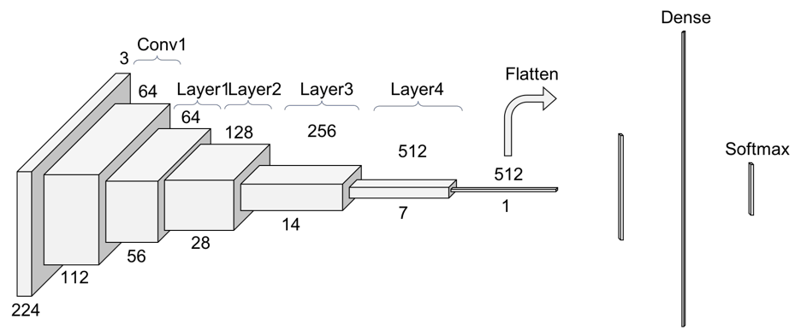
What is ResNet
ResNet is a deep learning architecture that introduced the concept of residual blocks to address the vanishing gradient problem.
It was proposed by Microsoft Research in 2015 and won the ImageNet challenge.
ResNet enables the training of extremely deep networks (e.g., 50 or more layers) without degradation in performance.
The architecture includes skip connections, which allow the network to learn residual mappings and propagate gradients effectively.
ResNet variants include ResNet50, ResNet101, and ResNet152, with varying depths.

Slide 11
Factorial Design Experiment
Factorial design is a research design commonly used in experimental studies to investigate the effects of multiple independent variables and their interactions on a dependent variable. It involves manipulating and studying the effects of two or more factors simultaneously.
In factorial design, each factor represents an independent variable, and each level of a factor represents a different condition or value of that variable. The combination of levels across all factors creates the different treatment conditions or groups.
The main advantage of factorial design is that it allows researchers to examine the independent and combined effects of multiple factors, as well as potential interactions between them. This helps to identify not only the main effects of each factor but also how the factors interact and influence the dependent variable.

Slide 12
What is the Factors we have considered for the image recognition?
Kernel Size determines the dimensions of the small matrix used to extract features, influencing the size and complexity of learned features.
Filter Values represent the number of filters in a convolutional layer, responsible for detecting different features in the input.
Pool Size determines the dimensions of the pooling window in pooling layers, affecting the amount of retained spatial information.
Dense Units refer to the number of neurons in fully connected layers, capturing complex relationships in the data.
Learning Rate controls the update rate of the model's weights based on calculated gradients, influencing convergence speed and stability.

Slide 13
Advantage of Factorial Design
Comprehensive exploration of multiple factors and interactions.
Efficient parameter tuning for improved performance.
Statistical significance for robust experimental results.
Reduction of bias in factor evaluation.
Notes:
It allows for the systematic evaluation of multiple factors and their interactions, providing a comprehensive understanding of their impact on the network's performance.
It helps identify the optimal combination of factors, such as architecture, hyperparameters, and data preprocessing techniques, leading to improved network performance.
Factorial design enables the application of statistical methods to determine the significance of factors and their interactions, enhancing the robustness of experimental results.
By systematically varying multiple factors simultaneously, factorial design helps reduce bias and provides a more unbiased assessment of the factors' effects on the network's performance.

Slide 14
Disadvantage of Factorial Design
Exponential growth in computational complexity and training time.
Requires a large sample size, limiting generalizability and statistical power.
Assumes independence, neglecting complex factor interactions.
High-dimensional parameter space hampers effective exploration and analysis.
Notes:
1.As the number of factors and levels increases in factorial design, the number of experiments or combinations to be evaluated grows exponentially. This can lead to a significant increase in computational complexity and training time for neural networks, especially when dealing with a large number of factors or levels.
2. Factorial design requires a sufficient sample size to evaluate all possible combinations of factors and levels. However, in some cases, obtaining a large sample size may not be feasible due to resource constraints or limitations in data availability. This limitation can affect the generalizability and statistical power of the experimental results.
3.Factorial design assumes that the effects of different factors are independent of each other. However, in neural networks, there can be complex interactions between factors that are not captured by the design. Ignoring these interactions can lead to inaccurate or incomplete understanding of the relationships between factors and their impact on the network's performance.
4.Neural networks often have a large number of parameters that need to be tuned during the training process. When applying factorial design, the number of factors can quickly increase with the number of parameters, resulting in a high-dimensional parameter space. This can make it challenging to explore and analyze the interactions between factors effectively.

Slide 15
What are the Parameters have we considered?
filters_values = [16, 32, 64, 128]
kernel_sizes = [(3, 3), (5, 5)]
pool_sizes = [(2, 2), (3, 3)]
dense_units_values = [64, 128]
learning_rates = [0.001, 0.01]

Slide 16
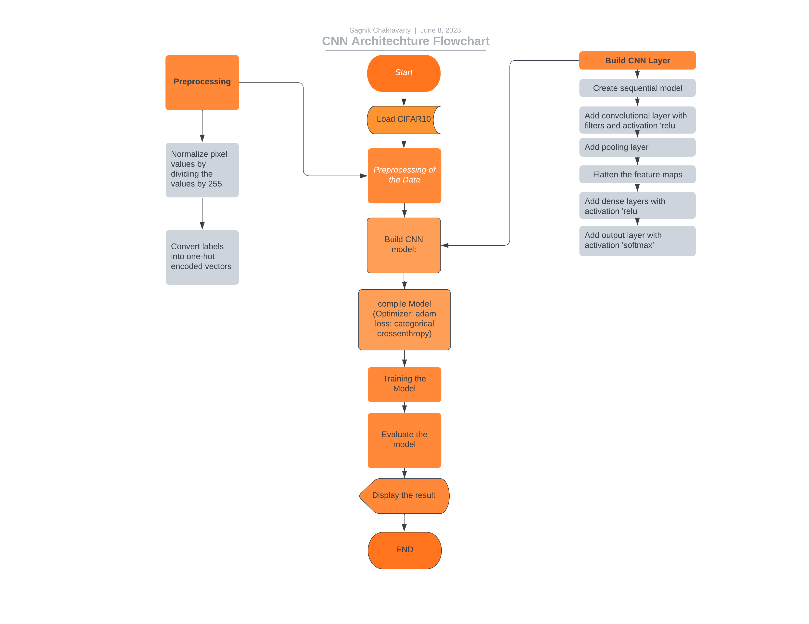
FlowChart for image recognition using CNN
Flowchart using only CNN

Slide 17
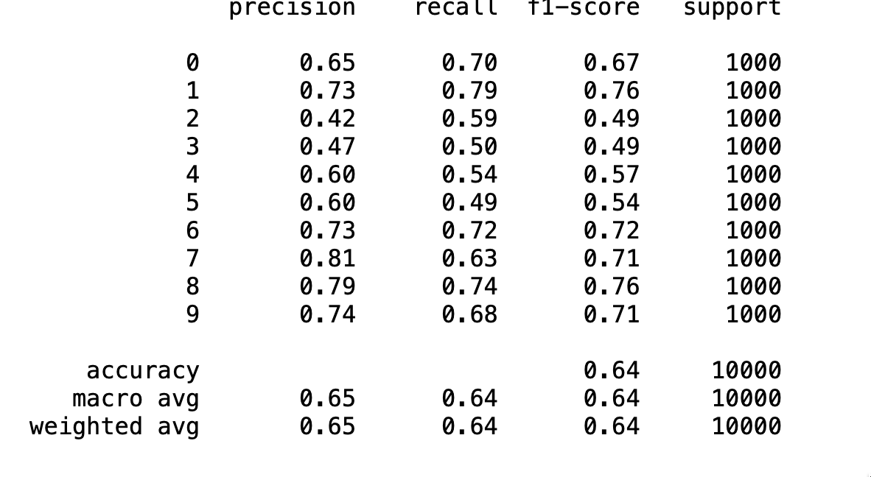
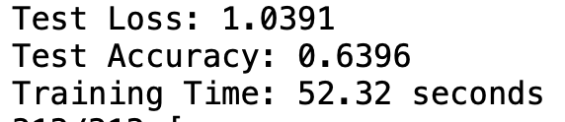
CNN Result

Slide 20
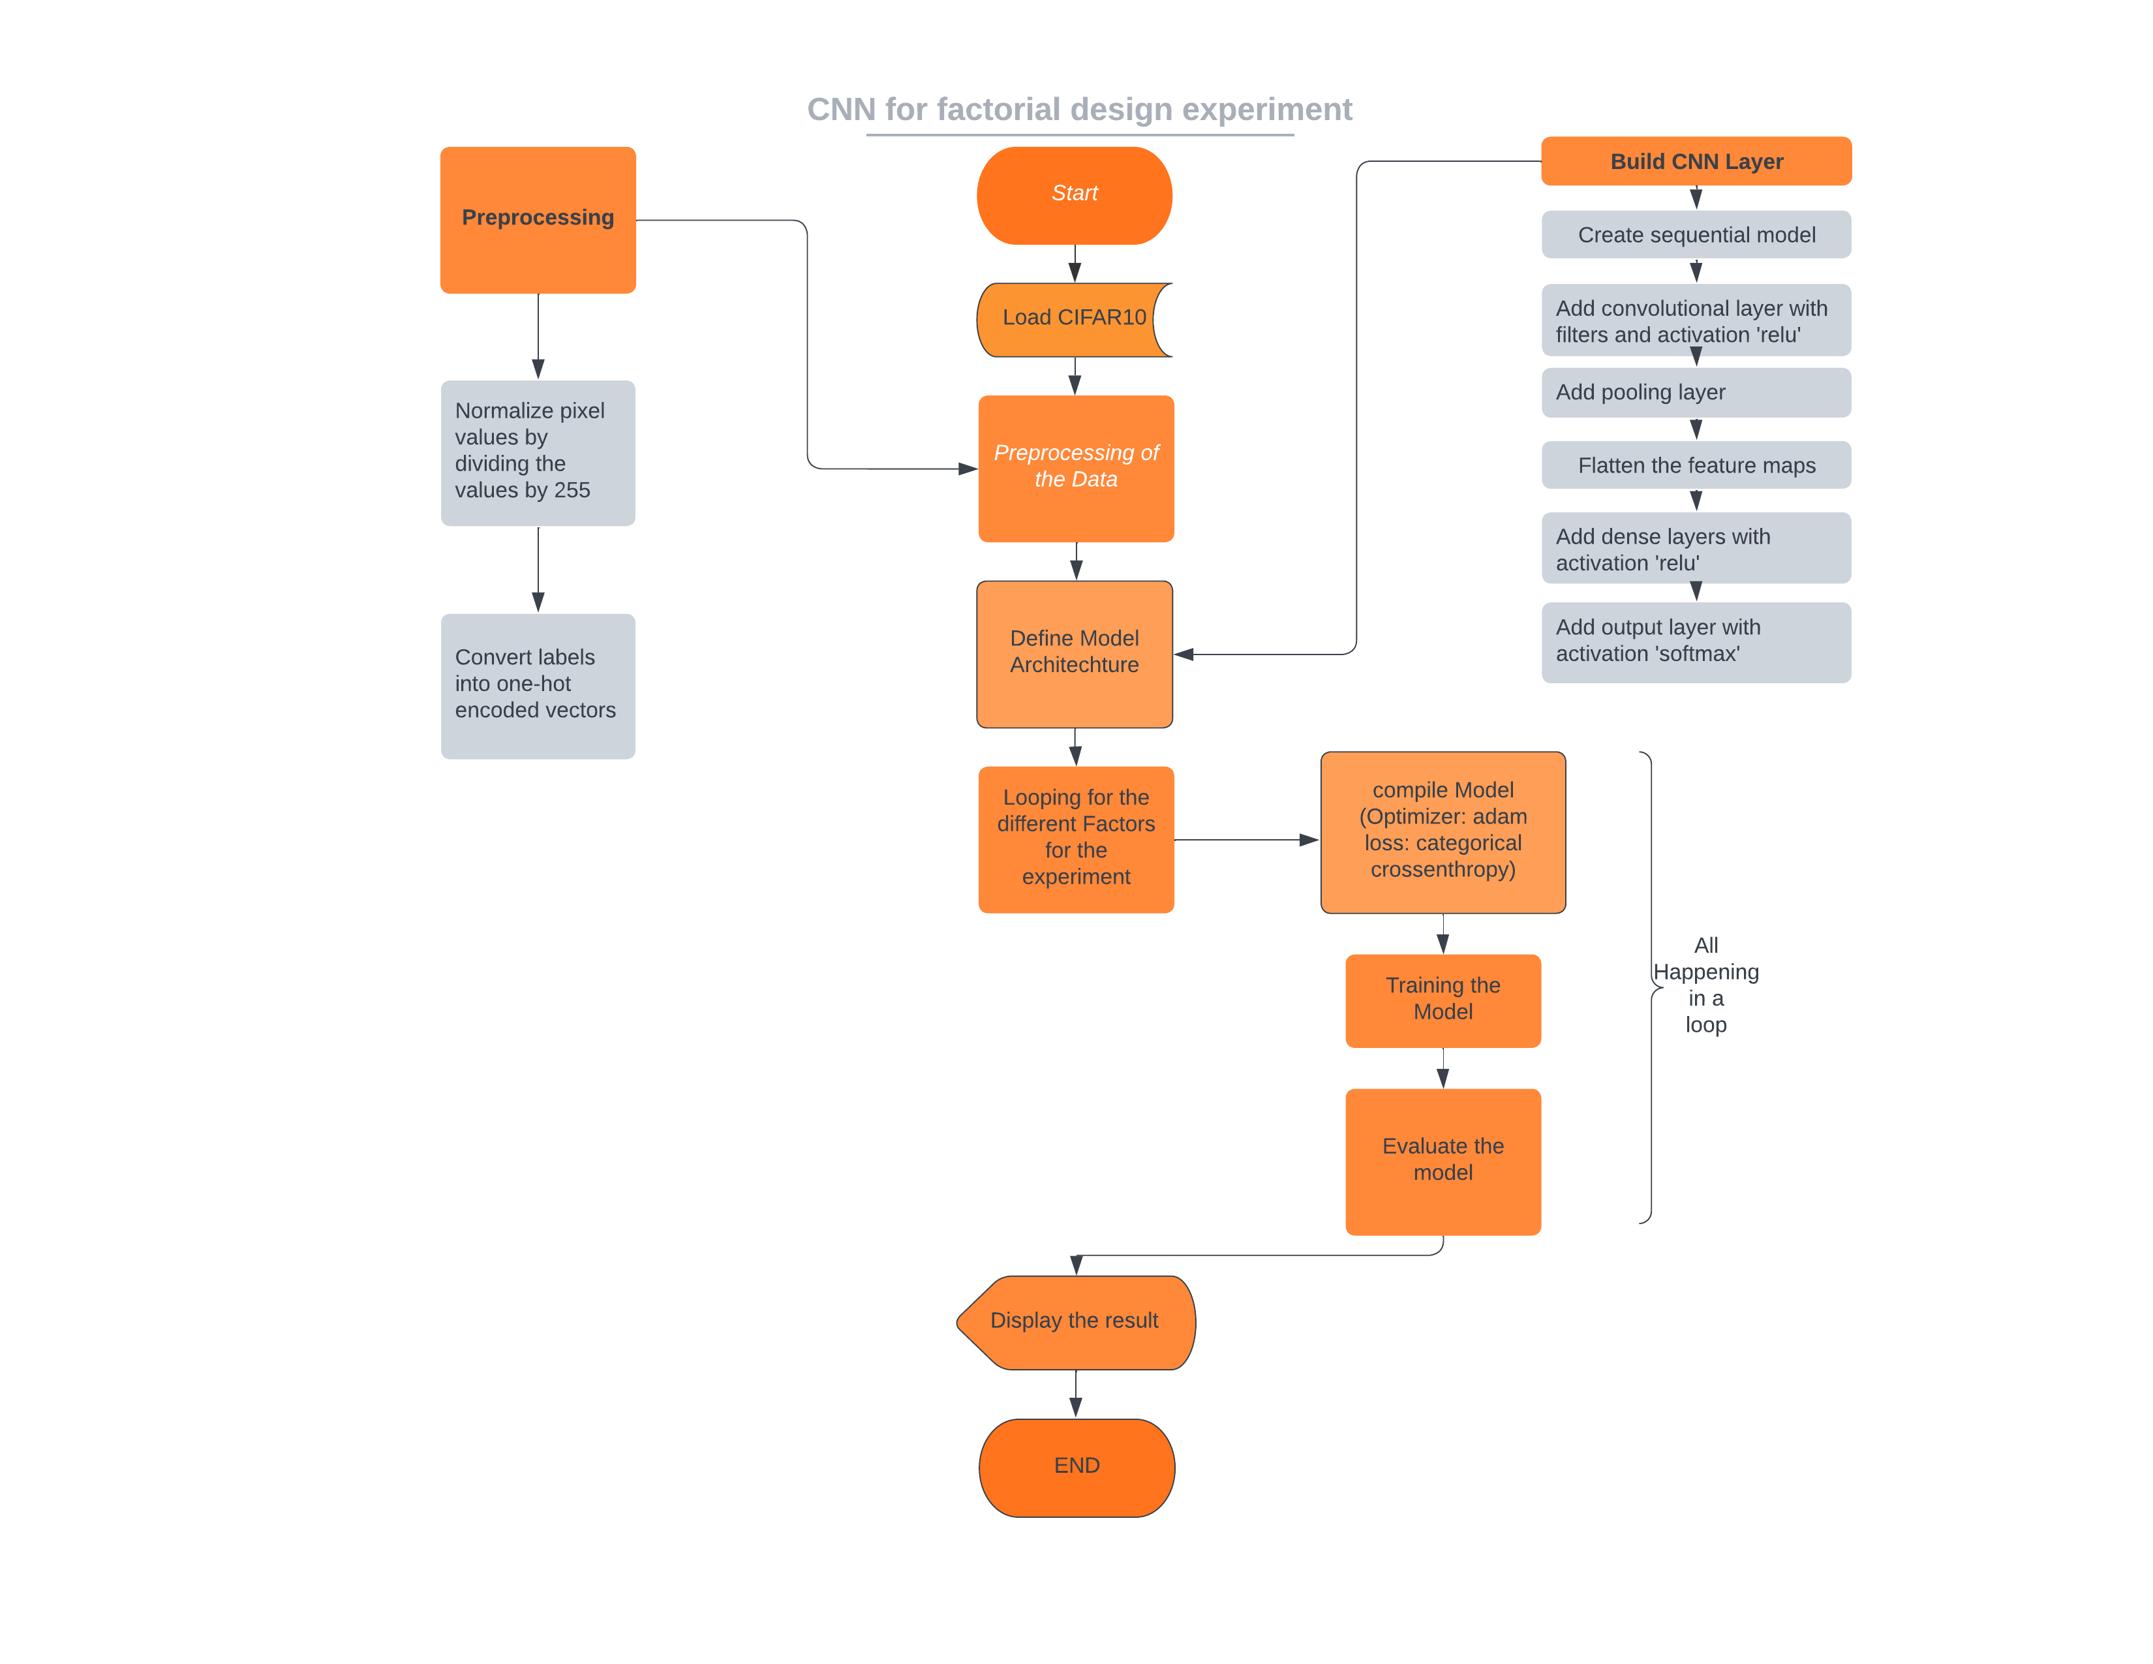
Flowchart for CNN with Factorial Design
Caption

Slide 21
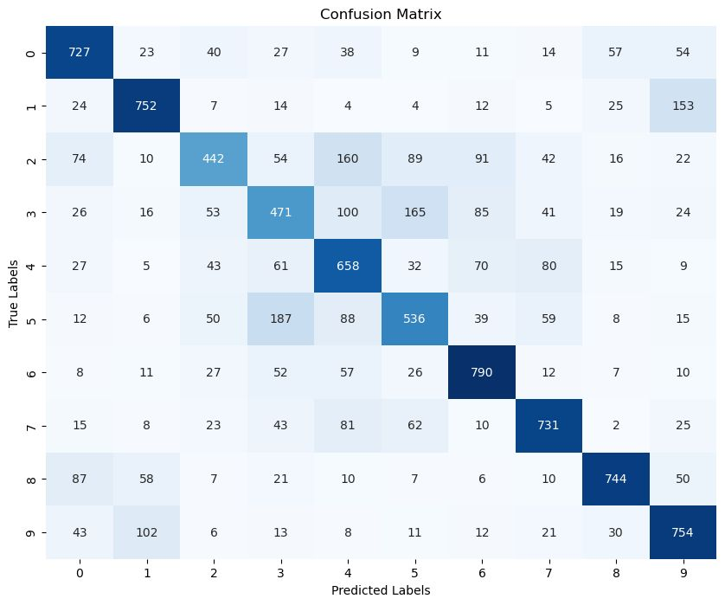

Slide 22
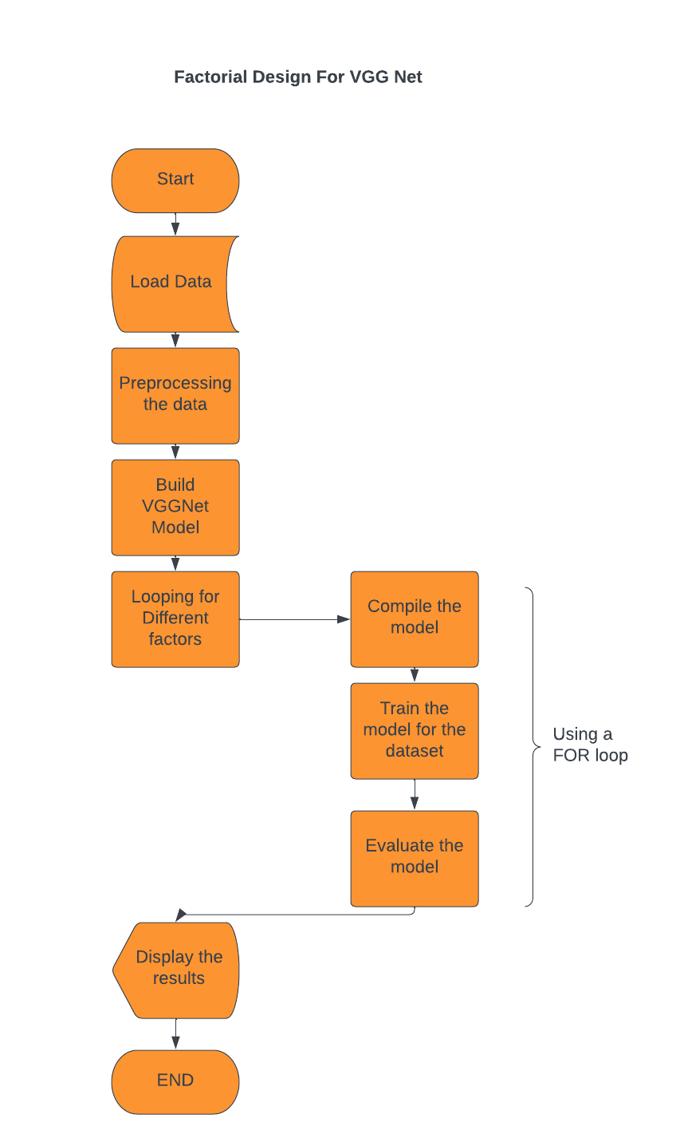

Flowchart for VGGNet and ResNet with Factorial design

Slide 23
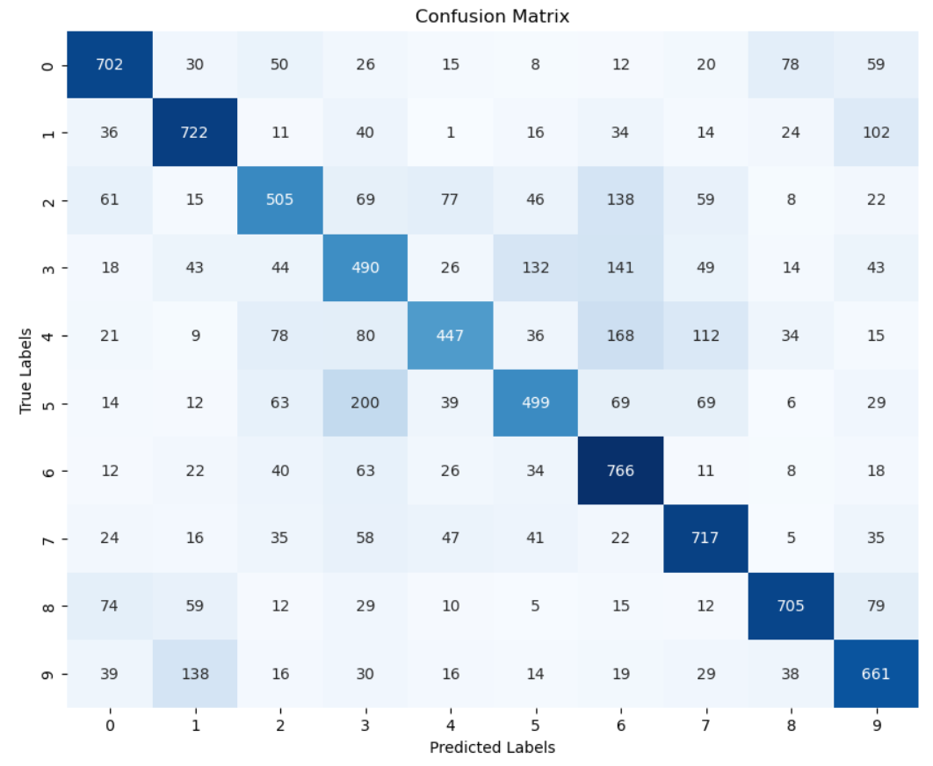
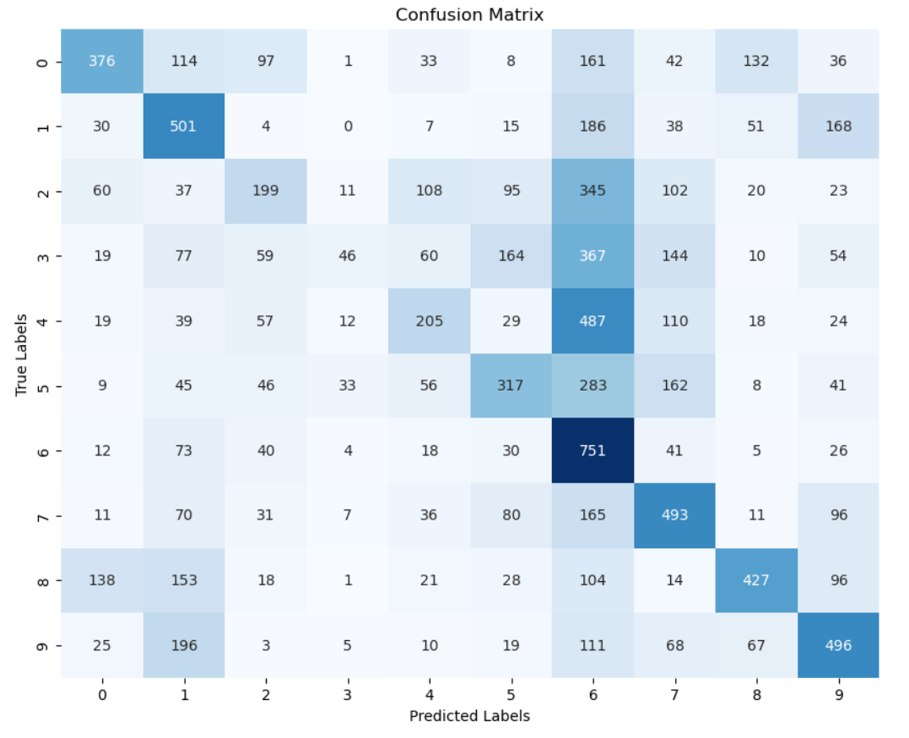

Slide 24
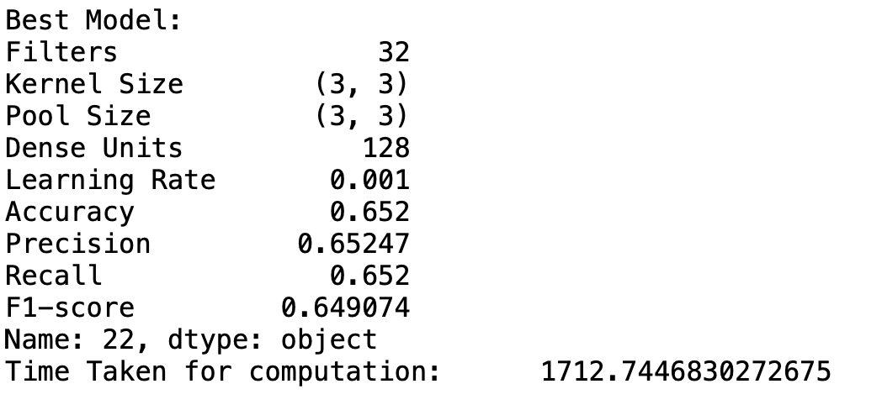
CNN while applying factorial design experiment

Slide 26
Conclusion
The accuracy of DenseNet with factorial design is greater
The time take by CNN by factorial design is nearly 35 times slower than only CNN
From the graph it is clear that factorial design took the most time to run, while dense neural network gave the most accuracy. From the factorial experiment the best configuration was found out to be as: Filters=128, KernelSize=( 3 , 3), PoolSize=( 3 , 3) , DenseUnits=128

Slide 27
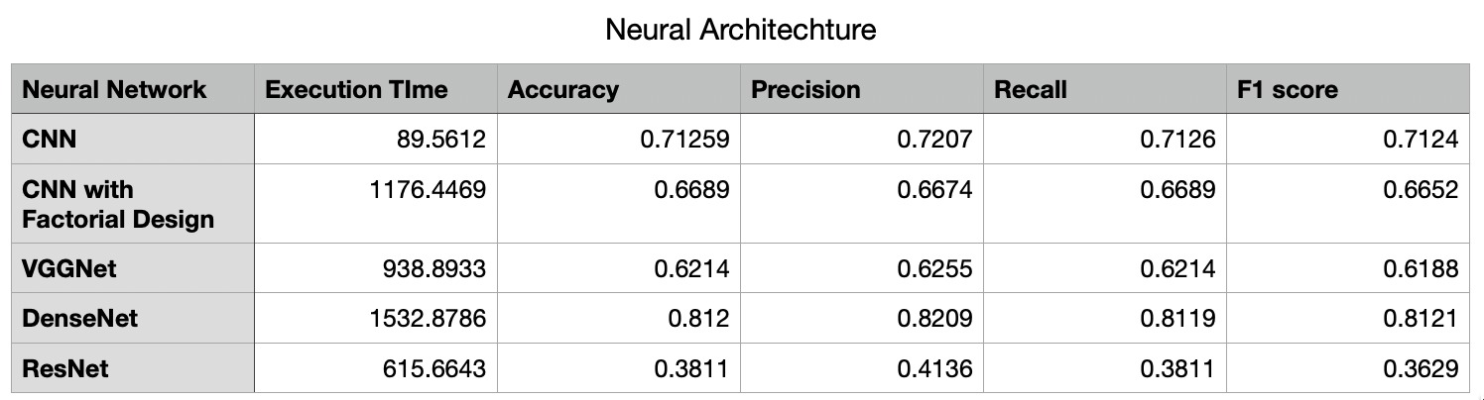

Slide 28
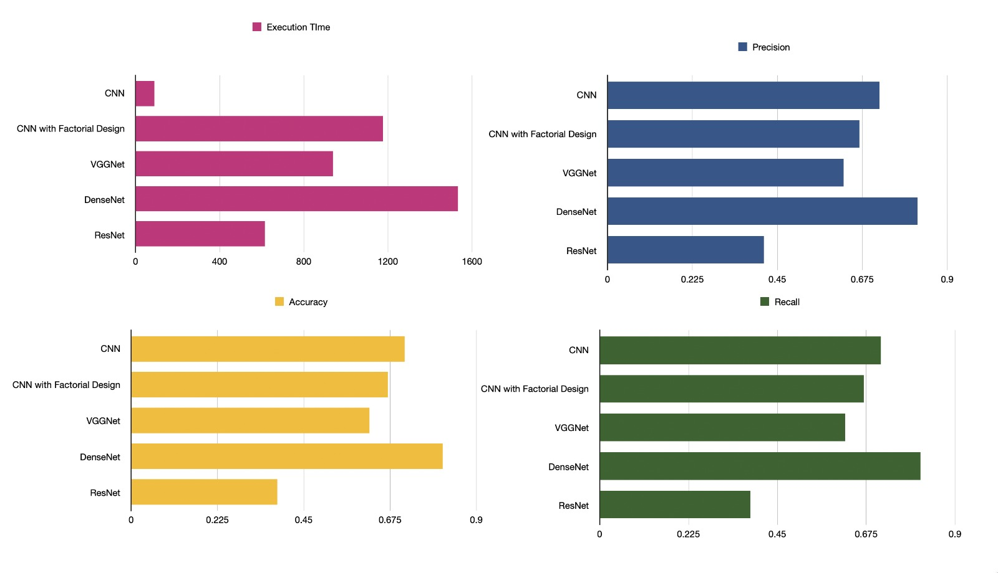

Slide 29
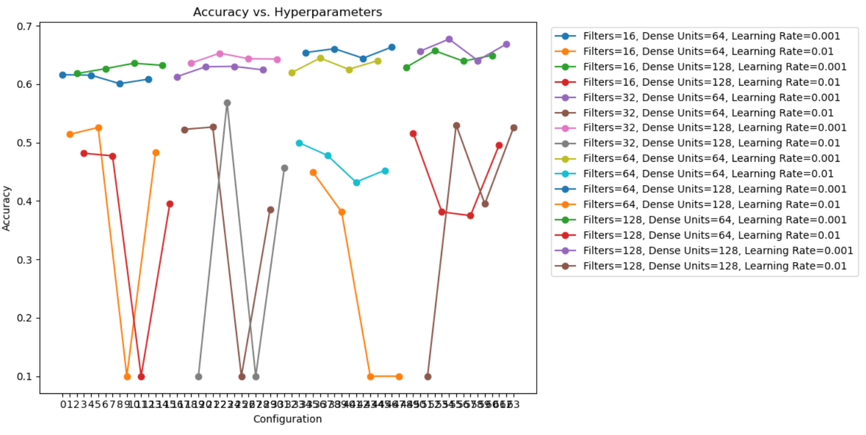

Slide 30
Thank You

